Slide 1
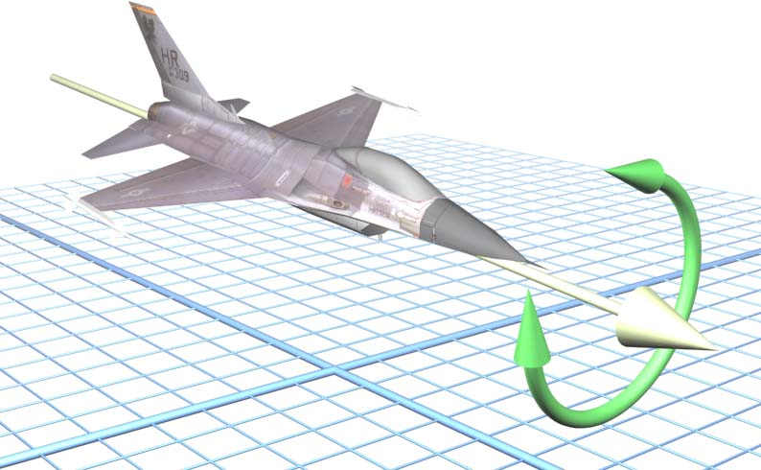

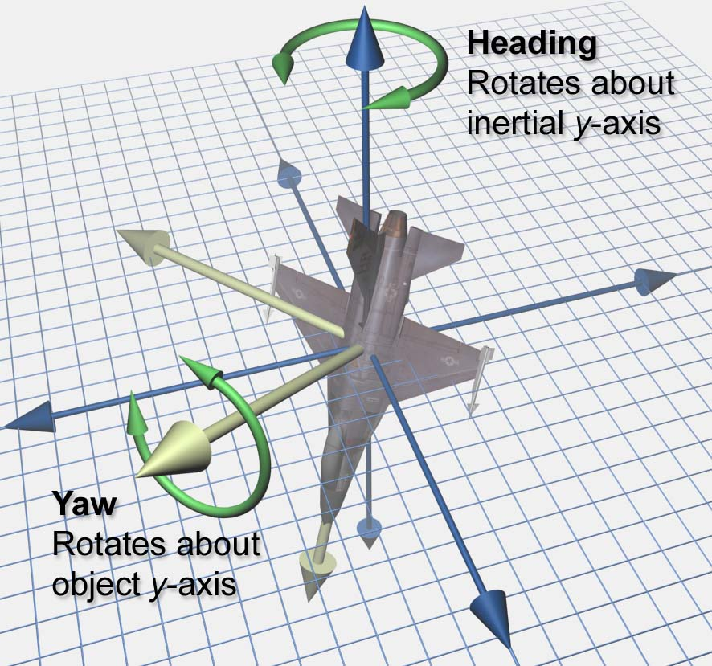
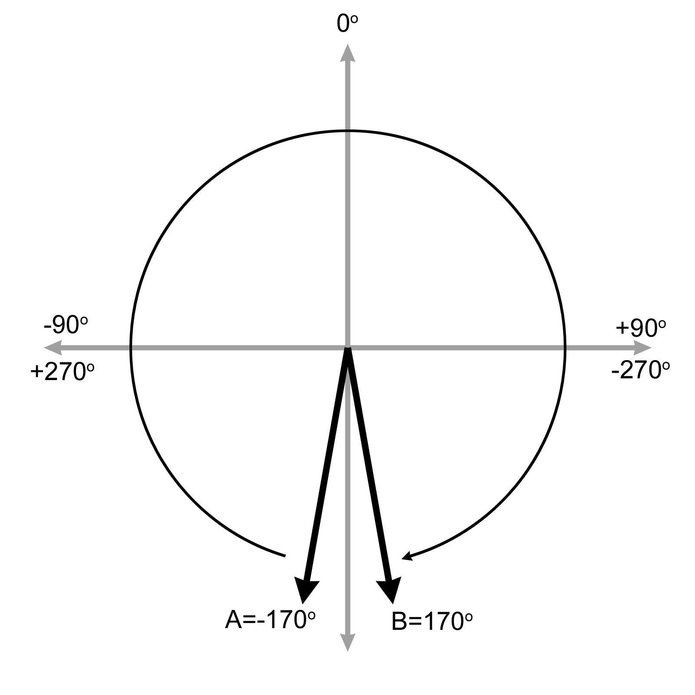
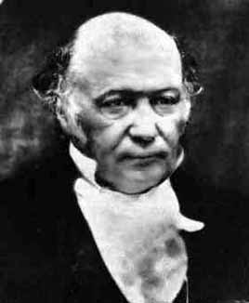
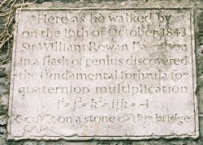
Chapter 8 Rotation in Three Dimensions
Fletcher Dunn
Valve Software
Ian Parberry
University of North Texas
3D Math Primer for Graphics & Game Development

Slide 2
What You’ll See in This Chapter
This chapter tackles the difficult problem of describing the orientation of an object in 3D, and the closely related concepts of rotation and angular displacement. It is divided into seven sections.
Section 8.1 discusses the subtle differences between terms like orientation, direction, and angular displacement.
Section 8.2 describes how to express orientation using a matrix
Section 8.3 describes how to express angular displacement using Euler angles.
Section 8.4 describes the axis-angle and exponential map forms.
Section 8.5 describes how to express angular displacement using a quaternion.
Section 8.6 compares and contrasts the different methods.
Section 8.7 explains how to convert an orientation from one form to another.

Slide 3
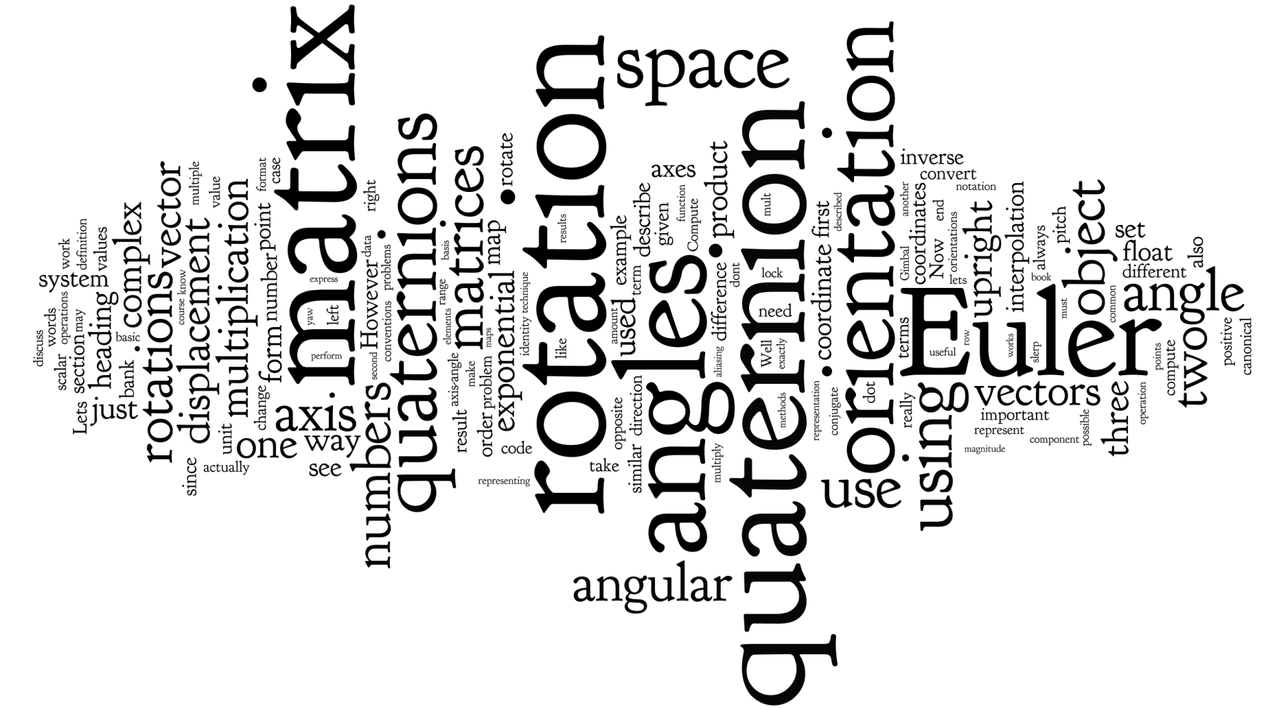
Word Cloud

Slide 4
Section 8.1: What Exactly is “Orientation”?

Slide 5
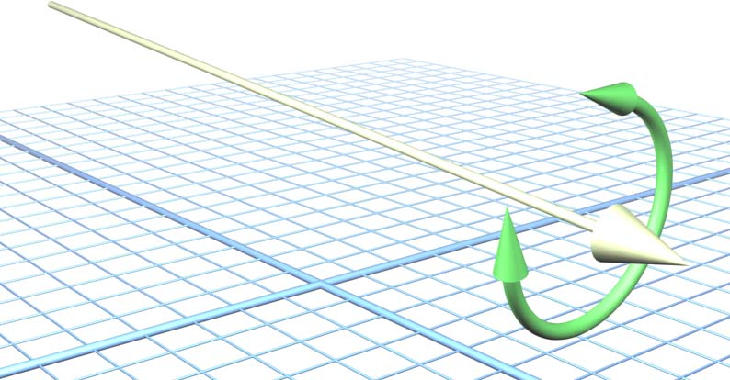
Orientation
What is orientation? More than direction.
A vector specifies direction but it can also be twisted.

Slide 6
This is Important Because
Twisting an object changes its orientation.

Slide 7
Some People Get Confused
Because you can specify a direction using two angles (polar coordinates)
Specifying an orientation requires 3 angles.
Or at least 3 numbers whichever way you represent it.
To add to the confusion, there are 3 popular ways to represent orientation.

Slide 8
What is Angular Displacement?
Orientation can’t be given in absolute terms.
Just as a position is a translation from some known point, an orientation is a rotation from some known reference orientation (often called the identity or home orientation).
The amount of rotation is known as an angular displacement.

Slide 9
How to Represent Orientation
Matrices
Euler angles
Quaternions

Slide 10
Section 8.2: Matrix Form

Slide 11
Matrix Form
List the relative orientation of two coordinate spaces by listing the transformation matrix that takes one space to another.
For example: from object space to upright space.
Transform back by using the inverse matrix.

Slide 12
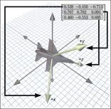
Example
We've seen how a matrix can be used to transform points from one coordinate space to another.
In the figure on the next slide, the matrix in the upper right hand corner can be used to rotate points from the object space of the jet into upright space.
We've pulled out the rows of this matrix to emphasize their direct relationship to the coordinates for the jet's body axes.
The rotation matrix contains the object axes expressed in upright space.
Simultaneously, it is a rotation matrix. We can multiply row vectors by this matrix to transform those vectors from object space coordinates to upright space coordinates.

Slide 13
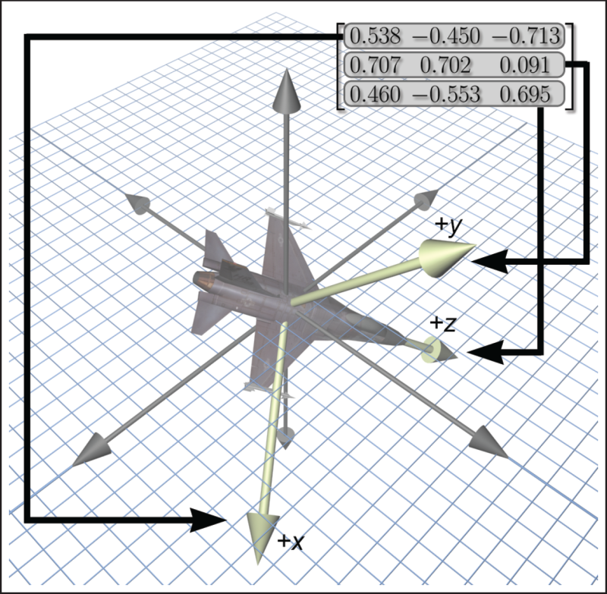

Slide 14
To Transpose or Not to Transpose? That is the Question
A legitimate question to ask is, why does the matrix contain the object space axes expressed using upright space coordinates? Why not the upright space axes expressed in object space coordinates?
Another way to phrase this is: why did we choose to give a rotation matrix that transformed vectors from object space to upright space? Why not from upright space to object space?
From a math perspective, this question is redundant. Because rotation matrices are orthogonal, their inverse is the same as their transpose. (Recall from Chapter 6.)
Thus the decision is entirely a cosmetic one.

Slide 15
A Coder’s Lament
But practically speaking, in our opinion, it is quite important.
At issue is whether you can write code that is intuitive to read and works the first time, or if it requires a lot of work to decipher, or a knowledge of conventions which are not stated since they are obvious to everyone but you.
Our opinions come from watching programmers grapple with rotation matrices. We don't expect that everyone will agree with us, but we hope that every reader will at least appreciate the value in considering these issues.

Slide 16
It’s Just a Matrix, Right?
Certainly every good math library will have a 3 x 3 matrix class that can represent any arbitrary transformation, which is to say that it makes no assumptions about the value of the matrix elements. (Or perhaps it is a 4 x 4 matrix that can do projection, or a 4 x 3 that can do translation but not projection – those distinctions are not important here.)
For a matrix like this, the operations inherently are in terms of some input coordinate space and an output coordinate space.
This is just implicit in the idea of matrix multiplication.
But if you need to go from output to input, then you need to obtain the inverse of the matrix.

Slide 17
But…
It is a common practice to use the generic transformation matrix class to describe the orientation of an object.
In this case, rotation is treated just like any other transformation. The interface remains in terms of a source and destination space.
It is our experience that the following two matrix operations are by far the most commonly used:
Take an object space vector and express it in upright coordinates.
Take an upright space vector and express it in object coordinates.

Slide 18
Which Matrix Should We Use?
Notice that we need to be able to go in both directions. We have no reason to believe that either direction is significantly more common that the other.
But more importantly, the very nature of the operations and the way programmers naturally think about the operations is in terms of object space and upright space (or some other equivalent terminology, such as parent space and child space).
We do not think of them in terms of a source space and a destination space. It is in this context that we wish to consider the question posed at the beginning of this section: which matrix should we use?

Slide 19
Orientation in a State Variable
First, we should back up a bit and remind ourselves of the mathematically moot but yet conceptually important distinction between orientation and angular displacement.
If your purpose is to create a matrix that does a specific angular displacement (such as “rotate 30° about the x-axis), then the two operations listed 2 slides ago are not really the ones you probably have in your head, and using a generic transform matrix with its implied direction of transformation is no problem, and so this discussion does not apply.
Instead, suppose that the orientation of some object is stored as a state variable.

Slide 20
We’re All Coders, Right?
Let's assume that we adopt the common policy and store orientation using the generic transformation matrix.
We'll arbitrarily pick a convention that multiplication by this matrix will transform from object to upright space.
If we have a vector in upright space and we need to express it in object space coordinates, we must multiply this vector by the inverse of the matrix.
Now let's see how our policy affects the code that is written and read hundreds of times by average game programmers.

Slide 21
In Code
Rotate some vector from object space to upright space is translated into code as multiplication by the matrix.
Rotate a vector from upright space to object space is translated into code as multiplication by the inverse of the matrix. (Actually, multiplication by the transpose, since rotation matrices are orthogonal, but that is not the point here.)

Slide 22
On Coding Style
Notice that the code does not match one-to-one with the high-level intentions of the programmer.
Furthermore, to read or write this code requires that you know what the conventions are.
It is our opinion that this coding style is a contributing factor to the difficulty that beginning programmers have in learning how to use matrices.

Slide 23
Just a Matrix?
An equivalent practice is to not use a class at all, and just declare a matrix with something like float R [3][3] .
This style of code will force every user to remember what the conventions are every time they use the matrix.
From our experience, they are usually not documented, since it was obvious to the author of this code how it was supposed to work.
This invariably results in fiddling and random transposing by the uninitiated, who are forced to reverse engineer the arbitrary conventions through trial and error.

Slide 24
A Rotation Matrix Class
An alternative way to code is to have a special 3 x 3 matrix class that is used exclusively for rotations.
It assumes, as an invariant, that the matrix is orthogonal, meaning it only contains rotation. (We also would probably assume that the matrix does not contain a reflection, even though that is possible in an orthogonal matrix.)
With these assumptions in place, we are now free to perform rotations using the matrix at a higher level of abstraction.
Our interface functions match exactly the high-level intentions of the programmer.

Slide 25
Some Justification
Furthermore, we have removed the confusing linear algebra details having to do with row vectors versus column vectors, which space is on the left or right, and which way is the regular way and which is the inverse, etc.
Or rather, we have confined such details to the class internals, the person implementing the class certainly needs to pick a convention (and hopefully document it).
In fact, in this specialized matrix class, the operations of multiply a vector and invert this matrix really are not that useful.
We advocate keeping this dedicated matrix class confined to operations that couch things in terms of upright space and object space, rather than multiply a vector.

Slide 26
If Frank Sinatra Was a Coder, Would He Do It His Way?
Of course, there are those who find it perfectly obvious which way the regular multiplication should go and which should be the transpose, and they don't understand why others can't keep it straight.
They might say, “You just use row vectors and regular multiplication rotates from object to upright, because that's the rotation that's needed the most frequently. What could be more obvious?”
The problem is that there are those who feel column vectors are better, or that the forward direction should go from upright to object space.
If these conventions are so obvious, then why doesn't everybody agree on what they should be?
In other words, coding for diversity is a good thing.

Slide 27
It Shouldn’t Matter
So, back to the question posed earlier: Which matrix should we use?
Our answer is “It shouldn't matter.”
By that we mean there is a way to design your matrix code in such a way that it can be used without knowing what choice was made.

Slide 28
What’s in a (Function) Name?
As far as writing real C++ code goes, this is purely a cosmetic change.
For example, perhaps we just replace the function name multiply () with objectToUpright(), and likewise we replace multiplyByTranspose() with uprightToObject().
Our argument is that the version of the code with descriptive, named coordinate spaces is easier to read and write.
The function names multiply() and multiplyByTranspose() have no descriptive value (they could be replaced with doTheThing() and doTheOtherThing() and no information is lost).
To use these functions requires you to know what “the thing” is and what “the other thing” is. But objectToUpright() and uprightToObject() are descriptive and self-contained.

Slide 29
Back to the Math
Enough on how our conventions encourage a robust coding style.
You will probably just ignore us and get into trouble, but we tried.

Slide 30
Direction Cosines Matrix
A direction cosines matrix is the same thing a a rotation matrix, but the term refers to a special way to interpret (or construct) the matrix.
The term direction cosines refers to the fact that each element in a rotation matrix is the dot product of a cardinal axis in one space with a cardinal axis in the other space.
For example, the center element m₂₂ in a 3 x 3 matrix gives the dot product that the y-axis in one space makes with the y-axis in the other space.

Slide 31
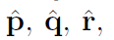
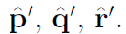
Direction Cosines Matrix
More generally, let's say that the basis vectors of a coordinate space are the mutually orthogonal unit vectors , while a second coordinate space with the same origin has as its basis a different (but also orthonormal) basis
The rotation matrix that rotates row vectors from the first space to the second is the matrix of direction cosines (dot products) of each pair of basis vectors, as follows:

Slide 32
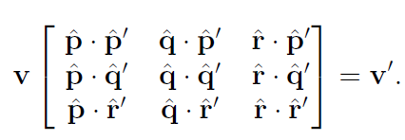
Direction Cosines Matrix
These axes can be interpreted as geometric rather than algebraic entities, so it really does not matter what coordinates are used to describe the axes (provided we use the same coordinate space to describe all of them), the rotation matrix will be the same.

Slide 33
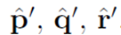
Example
For example, let's say that our axes are described using the first coordinate space.
Then have the trivial forms [1, 0, 0], [0, 1, 0] and [0, 0, 1], respectively.
The basis vectors of the second space, are not expressed in their own space, and thus they have arbitrary coordinates.
When we substitute the trivial vectors into the matrix on the previous slide and expand the dot products, we get:

Slide 34
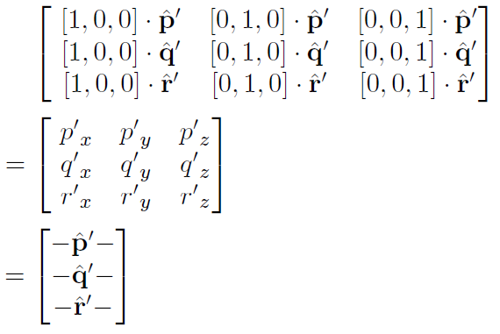

Slide 35
Conclusion
In other words, the rows of the rotation matrix are the basis vectors of the output coordinate space, expressed using the coordinates of the input coordinate space.
Of course, this fact is not just true for rotation matrices, it's true for all transformation matrices.
This is the central idea of why a transformation matrix works, which was developed in Chapter 4.

Slide 36
The Other Case
Now let's look at the other case.
Instead of expressing all the basis vectors using the first coordinate space, measure them using the second coordinate space (the output space).
This time, have trivial forms, and are arbitrary.
Putting these into the direction cosines matrix produces:

Slide 37
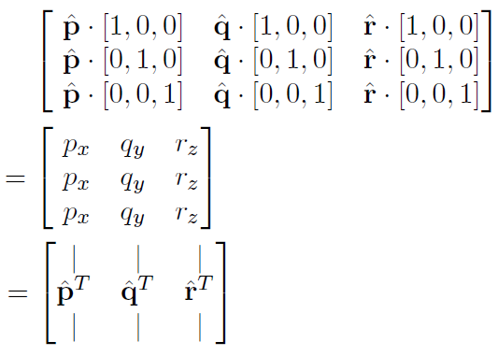
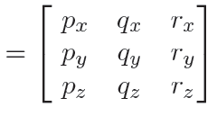

Slide 38
Conclusion
This says that the columns of the rotation matrix are formed from the basis vectors of the input space, expressed using the coordinates of the output space.
This is not true of transformation matrices in general; it applies only to orthogonal matrices such as rotation matrices.

Slide 39
Advantages of Matrix Form 1
Rotation of vectors is immediately available. You can use a matrix to rotate vectors between object and upright space. No other representation of orientation allows this in order to rotate vectors, you must convert the orientation to matrix form.

Slide 40
Advantages of Matrix Form 2
Format used by graphics APIs.
Graphics APIs use matrices to express orientation.
API stands for Application Programming Interface. Basically this is the code that you use to communicate with the graphics hardware.
When you are communicating with the API, you are going to have to express your transformations as matrices eventually.
How you store transformations internally in your program is up to you, but if you choose another representation you are going to have to convert them into matrices at some point in the graphics pipeline.

Slide 41
Advantages of Matrix Form 3
Concatenation of multiple angular displacements.
It is possible to collapse nested coordinate space relationships.
For example, if we know the orientation of object A relative to object B, and we know the orientation of object B relative to object C, then using matrices, we can determine the orientation of object A relative to object C.
We have encountered these concepts before, when we learned about nested coordinate spaces in Chapter 3, and then discussed how matrices could be concatenated in Chapter 5.

Slide 42
Advantages of Matrix Form 4
Matrix inversion.
When an angular displacement is represented in matrix form, it is possible to compute the opposite angular displacement using matrix inversion.
What's more, since rotation matrices are orthogonal, this computation is a trivial matter of transposing the matrix.

Slide 43
Disadvantages of Matrix Form 1
Matrices take more memory.
If we need to store many orientations (for example, keyframes in an animation sequence), that extra space for nine numbers instead of three can really add up.
Let's take a modest example. Let's say we are animating a model of a human that is broken up into 15 pieces for different body parts. Animation is accomplished strictly by controlling the orientation of each part relative to its parent part.
Assume we are storing one orientation for each part, per frame, and our animation data is stored at a reasonable rate, say, 15hz.
This means we will have 225 orientations per second. Using matrices and 32-bit floating point numbers, each frame will take 8,100 bytes.
Using Euler angles (which we will meet next), the same data would only take 2700 bytes. For a mere 30 seconds of animation data, matrices would take 162K more than the same data stored using Euler angles!

Slide 44
Disadvantages of Matrix Form 2
Difficult for humans to use.
Matrices are not intuitive for humans to work with directly. There are just too many numbers, and they are all from –1 to 1.
What's more, humans naturally think about orientation in terms of angles, but a matrix is expressed using vectors.
With practice, we can learn how to decipher the orientation from a given matrix. (Although the techniques from Chapter 4 for visualizing a matrix help a lot.)
But still this is much more difficult than Euler angles, and going the other way is much more difficult

Slide 45
Disadvantages of Matrix Form 3
Matrices can be malformed.
A matrix uses nine numbers, when only three are necessary. In other words, a matrix contains six degrees of redundancy.
There are six constraints that must be satisfied in order for a matrix to be valid for representing an orientation.
The rows must be unit vectors, and they must be mutually perpendicular.

Slide 46
How Can Matrices Get Malformed?
We may have a matrix that contains scale, skew, reflection, or projection. Any non-orthogonal matrix is not a well-defined rotation matrix. Reflection matrices (which are orthogonal) are not valid rotation matrices either.
We may just get bad data from an external source. For example, if we are using a physical data acquisition system, such as motion capture, there could be errors due to the capturing process. Many modeling packages are notorious for producing malformed matrices.
We can actually create bad data due to floating point roundoff error. For example, suppose we apply a large number of incremental changes to an orientation, which could routinely happen in a game or simulation that allows a human to interactively control the orientation of an object. The large number of matrix multiplications, which are subject to limited floating point precision, can result in an ill-formed matrix. Recall our discussion of matrix creep in Chapter 6.

Slide 47
Summary of Matrix Form 1
Matrices are a brute force method of expressing orientation: we explicitly list the basis vectors of one space in the coordinates of some different space.
The matrix form of representing orientation is useful primarily because it allows us to rotate vectors between coordinate spaces.
Modern graphics APIs express orientation using matrices.
We can use matrix multiplication to collapse matrices for nested coordinate spaces into a single matrix.

Slide 48
Summary of Matrix Form 2
Matrix inversion provides a mechanism for determining the opposite angular displacement.
Matrices take two to three times as much memory as the other techniques we will learn. This can become significant when storing large numbers of orientations, such as animation data.
The numbers in a matrix aren't intuitive for humans to work with.
Not all matrices are valid for describing an orientation. Some matrices contain mirroring or skew. We can end up with a malformed matrix either by getting bad data from an external source, or through matrix creep.

Slide 49
Section 8.3: Euler Angles

Slide 50
Euler Angles
Euler angles are another common method of representing orientation.
Euler is pronounced “oiler,” not “yoolur.”
They are named for the famous mathematician who developed them, Leonhard Euler (1707 –1783).
(Image from Wikimedia Commons.)

Slide 51
Euler Angles
Specify orientation as a series of 3 angular displacements from upright space to object space.
Which axes? Which order?
Need a convention.
Heading-pitch-bank
Heading: rotation about y axis (aka “yaw”)
Pitch: rotation about x axis
Bank: rotation about z axis (aka “roll”)

Slide 52
Implementing Euler Angles
Each game object keeps track of its current heading, pitch, and bank angles (the “Euler angles”).
It also keeps track of its heading, pitch, and bank change rate.
In each frame, calculate how much the object has changed its heading, pitch, and bank based on the amount of time since the last frame, and add this to the Euler angles.

Slide 53
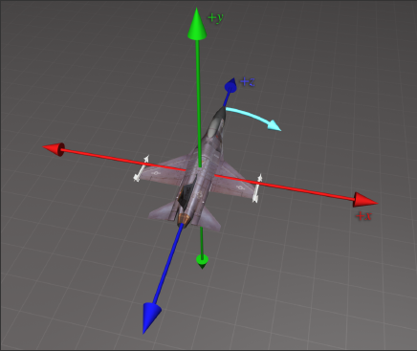
Heading

Slide 54
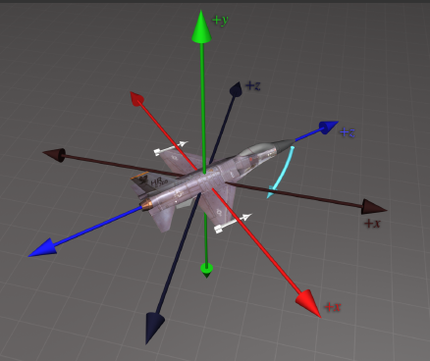
Pitch

Slide 55
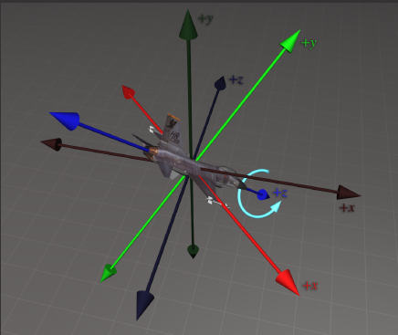
Bank

Slide 56
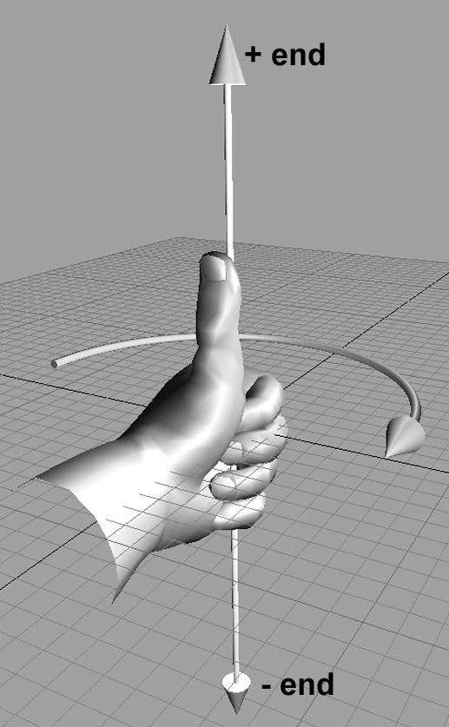
The Sign Matters
Use the hand rule again.
Thumb points along positive axis of rotation.
Fingers curl in direction of positive rotation.

Slide 57
The Order Matters
Heading is first: it is relative to the upright frame of reference – that is, vertical.
Pitch is next because it is relative to the horizon. But the x-axis may have been moved by the heading change. (Object x is no longer the same as upright x.)
Bank is last. The z-axis may have been moved by the heading and pitch change. (Object z is no longer the same as upright z.)

Slide 58
What’s in a Name?
Heading-pitch-bank is often called yaw-pitch-roll (at the time of writing, the latter has a Wikipedia page but the former doesn’t)
Heading is yaw, bank is roll.
This came from the aerospace industry, where yaw in fact doesn’t mean heading the way we interpret it.
Other less common terms are often used.
Heading also goes by the name azimuth.
Pitch is also called attitude or elevation.
Bank is sometimes called tilt, or twist.

Slide 59
Back to Yaw-pitch-roll
Perhaps more interesting is that fact that you will often hear these same three words listed in the opposite order: roll-pitch-yaw.
As it turns out, there is a perfectly reasonable explanation for this backwards convention: it's the order that we actually do the rotations inside a computer!

Slide 60
The Fixed-Axis System
In an Euler angle system, the axes of rotation are the body axes, which change after each rotation.
In a fixed-axis system, the axes of rotation are the upright space axes.

Slide 61
Example
The fixed-axis system and the Euler angle system are equivalent, provided that you take the rotations in the opposite order. Let's say we have a heading (yaw) of h and a pitch of p.
According to the Euler angle convention:
We first do the heading and rotate about the object space y-axis by h.
Then we rotate about the object space x-axis by p.
Using a fixed-axis scheme we get to this same ending orientation by doing the rotations in the opposite order.
First, we do the pitch, rotating about the upright x-axis by p.
Then, we perform the heading, rotating about the upright y-axis by h.

Slide 62
More Later
Although we might visualize Euler angles, inside a computer when rotating vectors from upright space to object space, we will actually use a fixed-axis system.
We'll discuss this in greater detail when we learn how to convert Euler angles to a rotation matrix.

Slide 63
Advantages of Euler Angles
Easy for humans to use. Really the only option if you want to enter an orientation by hand.
Minimal space – 3 numbers per orientation. Bottom line: if you need to store a lot of 3D rotational data in as little memory as possible, as is very common when handling animation data, Euler angles (or exponential map format – to be discussed later) are the best choices.
Another reason to choose Euler angles when you need to save space is that the numbers you are storing are more easily compressed.
Every set of 3 numbers makes sense – unlike matrices and quaternions.

Slide 64
Disadvantages of Euler Angles
Aliasing
Gimbal (or gymbal) lock
Interpolation problems

Slide 65
Aliasing
There are many ways to represent a single orientation, eg. Pitch down 135° is the same as heading 180°, pitch down 45°, then bank 180°.
This is called the aliasing problem.
Makes it hard to convert orientations from object to world space, eg. “Am I facing East?”

Slide 66
Canonical Euler Angles
Limit heading (y) to ±180°
Limit pitch (x) to ±90°
Limit bank (z) to ±180°
Now each orientation has a unique canonical Euler angle.
Except for one more irritating thing.

Slide 67
Gimbal Lock
Change heading (y axis) by 45°
Pitch down 90°
Now if you bank, your object space z axis is pointing in world space where your object space y axis was before you started your rotations. So any rotation about z could have been done as a heading change.

Slide 68
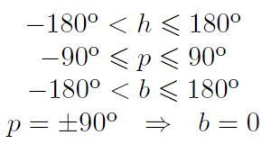
Canonical Euler Angles
Fix this (i.e. make canonical Euler angles unique) by insisting that if pitch is 90°, then bank must be zero. Put the bank rotation in the heading instead.

Slide 69
Hint for Programmers
When writing C++ that accepts Euler angle arguments, it's usually best to ensure that they work given Euler angles in any range.
Luckily this is usually pretty easy, and frequently just automatically works without taking any extra precaution, especially if the angles are fed into trig functions.
However, when writing code that computes or returns Euler angles, it's a good practice to try to return the canonical Euler angle triple.

Slide 70
More on Gimbal Lock
It is a common misconception that, because of Gimbal lock, certain orientations cannot be described using Euler angles.
Actually, for the purposes of describing an orientation, aliasing doesn't pose any problems.
To be clear, any orientation in 3D can be described using Euler angles, and that representation is unique within the canonical set.
Also, as we mentioned earlier, there is no such thing as an invalid set of Euler angles. Even if the angles are outside the usual range, we can always agree what orientation is described by the Euler angles.

Slide 71
Aliasing and Gimbal Lock
What's the fuss about aliasing and Gimbal lock?
Let's say we wish to interpolate between two orientations R₀ and R₁.
That is, for a given parameter t, 0 ≤ t ≤ 1, we wish to compute an intermediate orientation R(t) that interpolates smoothly from R₀ to R₁ as t varies from 0 to 1.
This is extremely useful for character animation and camera control, for example.

Slide 72
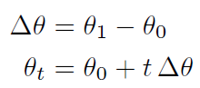
The Dangers of Lerping
The naive approach to this problem is to apply the standard linear interpolation formula (lerp for short) to each of the three angles independently.

Slide 73
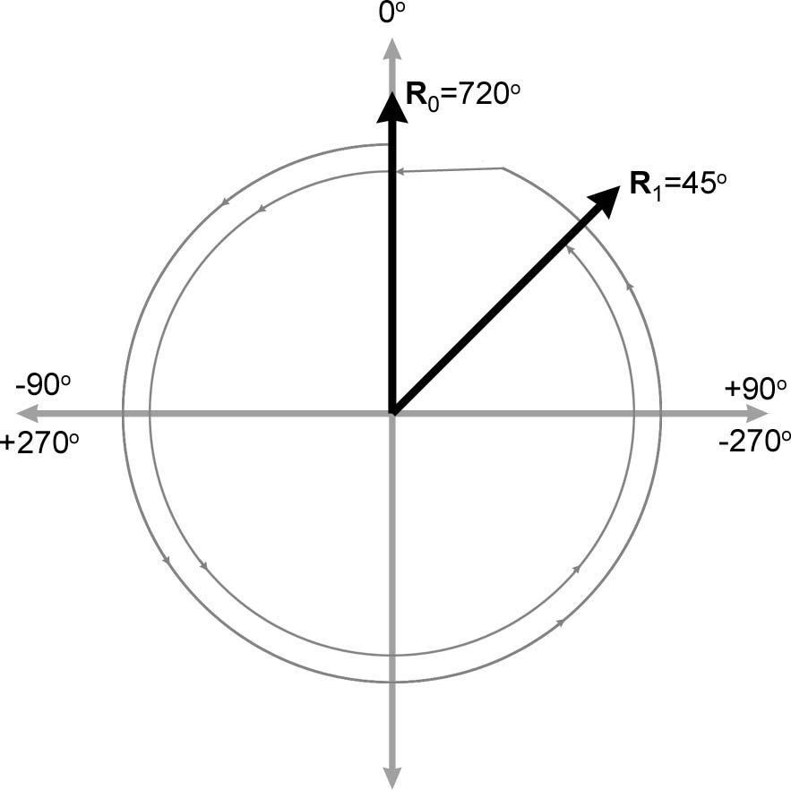
Problems
Not good with non-canonical angles.
For example, to interpolate from 720° to 45° in 1° increments would mean turning around twice.

Slide 74
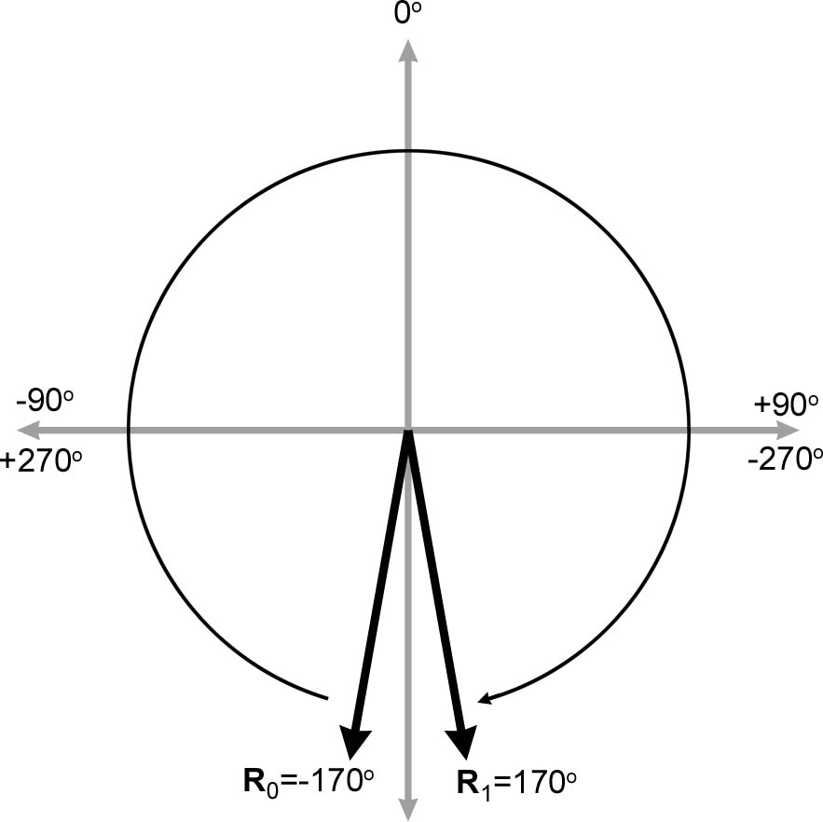
What About Canonical Euler Angles?
This can even happen with canonical Euler angles, for example, from –170° to 170°.
It goes the “long way round”.

Slide 75

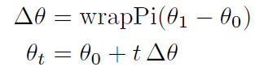
Function wrapPi
Define the following function:
Using wrapPi() makes it easy to take the shortest arc when interpolating between two angles.
Here’s the code for wrapPi() (next slide):

Slide 76
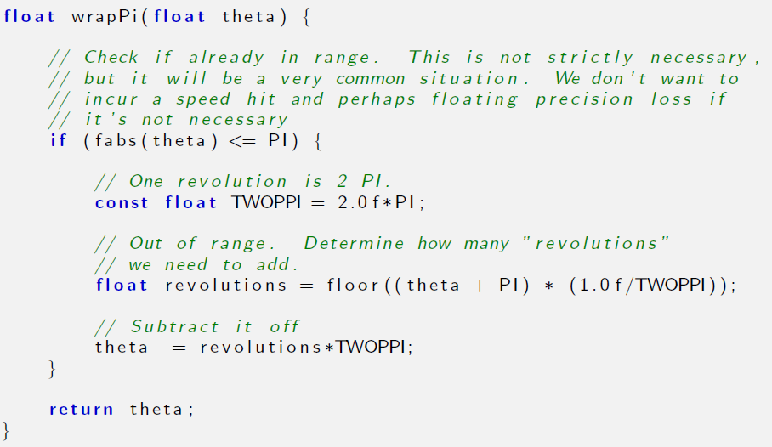

Slide 77
Another Problem
Even with these two band-aid solutions, you are left with gimbal lock.
Solution: don’t use Euler angles for interpolation. Use something else, like quaternions.

Slide 78
Visualizing Gimbal Lock
If you have never experienced what Gimbal lock looks like, you may be wondering what all the fuss is about.
Fortunately, it's easy to find an animation demonstrating the problem: just do a YouTube search for “gimbal lock.” For example, http://www.youtube.com/watch?v=zc8b2Jo7mno

Slide 79
Summary of Euler Angles 1
Euler angles store orientation using three angles. These angles are ordered rotations about the three object-space axes.
The most common system of Euler angles is the heading-pitch-bank system. Heading and pitch tell which way the object is facing, with heading giving a compass reading and pitch measuring the angle of declination. Bank measures the amount of twist.
In a fixed-axis system, the rotations occur about the upright axes rather than the moving body axes. This system is equivalent to Euler angles provided that we perform the rotations in the opposite order.
Lots of smart people use lots of different terms for Euler angles, and they can have good reasons for using different conventions. It's best not to rely on terminology when using Euler angles. Always make sure you get a precise working definition, or you're likely to get very confused.
In most situations, Euler angles are more intuitive for humans to work with compared to other methods of representing orientation.

Slide 80
Summary of Euler Angles 2
When memory is at a premium, Euler angles use the minimum amount of data possible for storing an orientation in 3D, and Euler angles are more easily compressed than quaternions.
There is no such thing as an invalid set of Euler angles. Any three numbers have a meaningful interpretation.
Euler angles suffer from aliasing problems, due to the cyclic nature of rotation angles, and because the rotations are not completely independent of one another.
Using canonical Euler angles can simplify many basic queries on Euler angles. An Euler angle triple is in the canonical set if heading and bank are in range –180° to 180° and pitch is in range –90° to 90°. What's more, if pitch is ±90°, then bank is zero.
Gimbal lock occurs when pitch is ±90°. In this case, one degree of freedom is lost because heading and bank both rotate about the vertical axis.

Slide 81
Summary of Euler Angles 3
Contrary to popular myth, any orientation in 3D can be represented using Euler angles, and we can agree on a unique representation for that orientation within the canonical set.
The wrapPi function is a very handy tool that simplifies situations where we have to deal with the cyclic nature of angles. Such situation arise frequently in practice, especially in the context of Euler anglers, but at other times as well.
Simple forms of aliasing are irritating, but there are workarounds. Gimbal lock is a more fundamental problem and no easy solution exists. Gimbal lock is a problem because the parameter space of orientation has a discontinuity. This means small changes in orientation can result in large changes in the individual angles. Interpolation between orientations using Euler angles can freak out or take a wobbly path.

Slide 82
Section 8.4: Axis-Angle and Exponential Map

Slide 83
Euler's Rotation Theorem
Euler's Rotation Theorem: any 3D angular displacement can be accomplished via a single rotation about a carefully chosen axis.
That is, for every pair of orientations R₁ and R₂ there exists an axis n such that that we can get from R₁ to R₂ by performing a rotation about n.
Euler's Rotation Theorem leads to two closely-related methods for describing orientation.
We begin with some notation. Let's say we have chosen a rotation angle θ, and an axis of rotation that passes through the origin and is parallel to the unit vector n.

Slide 84
Exponential Maps
The two values n and θ describe an angular displacement in axis-angle form.
Alternatively, since n has unit length, without loss of information we can multiply it by θ, yielding the single vector e = θn.
This scheme for describing rotation goes by the rather intimidating and obscure name of exponential map.
The rotation angle can be deduced from the length of e, i.e. θ = ||e||, and the axis is obtained by normalizing e.
The exponential map is not only more compact than axis-angle (3 numbers instead of 4), it elegantly avoids certain singularities and has better interpolation and differentiation properties.

Slide 85
Multiples of Angular Displacements
We can directly obtain a multiple of an angular displacement.
For example, given a rotation in axis-angle form, we can get 1/3rd of the rotation, or 2.65 times the rotation, simply by multiplying θ by this amount.
Of course, we can do this same operation with the exponential map just as easily (by multiplying c).
Quaternions can do this through exponentiation, but an inspection of the math reveals that it's really using the axis-angle format under the hood.
Quaternions can also do a similar operation using slerp, but in a more roundabout way and without the ability for intermediate results to store rotations beyond 180°.
We'll look at quaternions later.

Slide 86
Exponential Map vs Axis-Angle
The exponential map gets more use than axis-angle.
Its interpolation properties are nicer than Euler angles.
Although it does have singularities (to be discussed below), they are not as troublesome as Euler angles.
Usually when one thinks of interpolating rotations one immediately thinks of quaternions, but for some applications such as storage of animation data, the under-appreciated exponential map is a viable alternative.
The most important and frequent use of the exponential map is not for angular displacement, but rather angular velocity, because the exponential map differentiates nicely (which is somewhat related to its nicer interpolation properties) and can represent multiple rotations easily.

Slide 87
Aliasing and Singularities
Like Euler angles, the axis-angle and exponential map forms exhibit aliasing and singularities, although of a slightly more restricted and benign manner.
There is an obvious singularity at the identity orientation, when θ = 0 and any axis may be used.
Notice, however, that the exponential map nicely tucks this singularity away, since the multiplication by θ causes e to vanish,.
Another trivial form of aliasing in axis-angle space can be produced by negating both θ and n.
However, the exponential map dodges this issue as well, since negating both θ and n leaves e = θn unchanged!

Slide 88
Other Aliases
The other aliases cannot be dispatched so easily.
As with Euler angles, adding a multiple of 360° to θ produces an angular displacement that results in the same orientation, in both the axis-angle and the exponential map.
However, this is not always a shortcoming – for describing angular displacement, this ability to represent such extra rotation is an important and useful property.
For example, it's quite important to be able to distinguish between rotation about the x-axis at a rate of 720° per second, versus rotation about the same axis at a rate of 1080° per second, even though these displacements result in the same ending orientation if applied for an integral number of seconds.
It is not possible to capture this distinction in quaternion format.

Slide 89
More on the Euler Rotation Theorem.
For any angular displacement described as a rotation matrix, there is a unique exponential map representation.
Although more than one exponential map may produce the same rotation matrix, it is possible to take a subset of the exponential maps (those for which ||e|| < 2π) and form a one-to-one correspondence with the rotation matrices.
This is the essence of the Euler Rotation Theorem.

Slide 90
Concatenating Rotations
Suppose e₁ and e₂ are rotations in exponential map format.
The result of performing the rotations in sequence, for example e₁ then e₂, is not the same as performing the rotation e₁ + e₂, because vector addition is commutative, but three-space rotations are not.
For example, suppose that e₁ is a 90° downward pitch rotation, and e₂ is a 90° Eastward heading rotation, that is, e₁ = [90°, 0, 0], and e₂ = [0, 90°, 0].
Performing e₁ followed by e₂, we would end up looking downward with our head pointing East, but doing them in the opposite order, we end up on our ear facing East.

Slide 91
Concatenating Small Rotations
However, if the angles were much smaller, say 2° instead of 90° then the ending orientations would be closer.
As we reduce the magnitude of the rotation angles, the importance of the order decreases, and at the extreme, for infinitesimal rotations, the order is completely irrelevant.
Hence for infinitesimal rotations, which are useful for describing angular velocity, exponential maps can be added vectorially,

Slide 92
Terminology Disclaimer
Alternative names for these concepts abound. We have tried to choose the most standard names we could, but it was difficult to find any consensus in the literature.
Some authors use the term axis-angle to describe both axis-angle and exponential map and don't really distinguish between them.
Even more confusing is the use of the term Euler axis to refer to either form (but not to Euler angles!).
Rotation vector is another term you might see attached to what we are calling exponential map.
Finally, the term exponential map, in the broader context of Lie algebra, from whence the term originates, actually refers to an operation (a map) rather than a quantity.

Slide 93
Section 8.5: Quaternions

Slide 94
Quaternions
Quaternions were invented by the Irish mathematician Sir William Rowan Hamilton in 1843.
They have been the cause of much puzzlement to students since then.
(Image from Wikimedia Commons.)

Slide 95
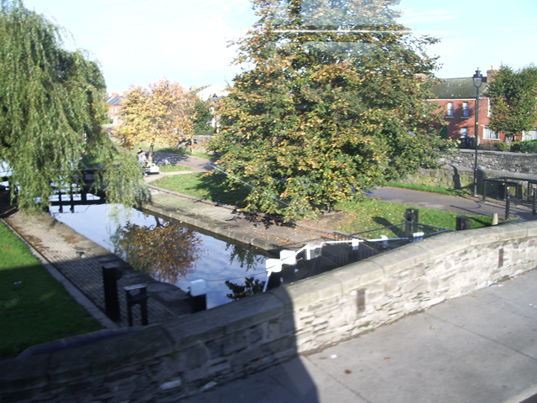
When Quaternions Were Invented
On the 16th of October, 1843, Hamilton left the Dunsink Observatory in Dublin (where he lived and was serving as Director), and walked along the Royal Canal.
His destination was the Royal Irish Academy at 19 Dawson Street in the center of Dublin.
(Image from Wikimedia Commons.)

Slide 96
Nerd Alert!
On his way, as he was passing over Broom (Brougham/Broome) Bridge, he discovered the fundamental quaternion formula:
i² = j² = k² = ijk = –1.
He was so excited about this that he scratched the formula onto the bridge with his penknife. No trace can be found today, but in 1958 a plaque was erected on the site.

Slide 97
(Image from Wikimedia Commons.)

Slide 98
Quaternions Version 1: Complex Number Notation
This notation is just like complex numbers, but with three imaginary parts, i, j, k.
q = w + xi + yj + zk.
Here’s how the imaginary parts interact:
i² = j² = k² = ijk = –1
ij = k, jk = i, ki = j
ji = –k, kj = –i, ik = –j
This is what Hamilton scratched on the bridge.

Slide 99
Quaternions Version 2: Vector-Scalar Notation
Instead of the imaginary number notation:
w + xi + yj + zk
use vector-scalar notation:
q = [ w v ],
where w is a scalar and v a vector. Alternatively:
q = [ w ( x y z ) ]
(it’s the same w, x, y, z).

Slide 100
Quaternions Version 3: 4D Space
Hamilton himself thought of quaternions as 4D vectors [w, x, y, z].
However, quaternions are not the same as vectors in homogenous 4D space [x, y, z, w].
In particular, his w is not the same as the w in homogenous 4D space.

Slide 101
What was Hamilton Thinking?
He was looking for a way to extend complex numbers from 2D into 3D.
That’s the normal complex numbers you’ve probably met before, c = x + yi where
i² = –1
What’s the link between complex numbers and 2D geometry?

Slide 102
2D and Complex Numbers
Instead of thinking of a point (x, y) in 2D space as two real numbers, think of it as a single complex number x + yi.
A rotation by angle θ can be also be represented as a complex number
cos θ + i sin θ
Complex numbers are doing double duty here as both points and rotations.

Slide 103
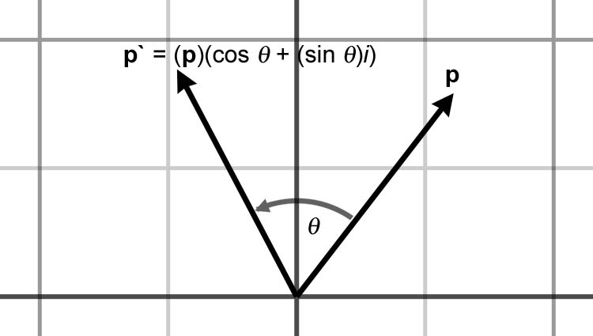
Complex Multiplication
A rotation (represented as a complex number) can be applied to a point (also represented as a complex number) using multiplication of complex numbers.
(x + yi) (cos θ + i sin θ )
= (x cos θ – y sin θ ) + i (x sin θ + y cos θ )

Slide 104
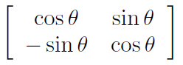
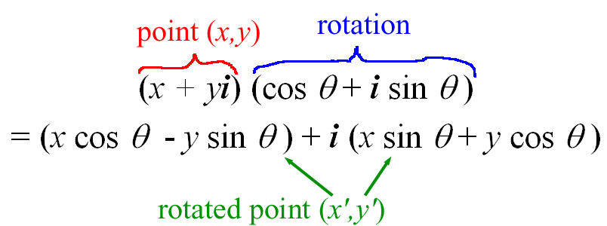
What’s Going On Here?
Remember the 2D rotation matrix. The imaginary part captures the negative sign on the sine (so to speak).

Slide 105
What Do Imaginary Numbers Buy Us?
The imaginary part seems to have two roles.
It allows us to “jam together” the x and y part from a vector [x, y] into a single number x + yi. The imaginary part i keeps the x and y parts separate.
It gets us the sign change on the sin θ that we saw in rotation matrices.

Slide 106
So What Was He Thinking?
Hamilton wanted to extend this to 3D rotations.
His intuition told him that he needed 2 imaginary parts i and j. That makes sense, 1 imaginary part for 2D, and 2 imaginary parts for 3D.
He got fixated on that.
For some reason his mental block cleared on the bridge: 3 imaginary parts is the way to go.

Slide 107
In the Back of His Mind
It was known as far back as Euler that axial rotations are closed under composition.
What does this mean?
If an object rotates around two or more axes simultaneously, the result is a rotation about a single axis.

Slide 108
Points as Quaternions
Represent 3D point ( x y z ) as the quaternion
p = [ 0 ( x y z ) ].
Or equivalently in complex number notation:
xi + yj + zk.
Games generally don’t implement the 0 value for w.

Slide 109
Rotations as Quaternions
The scalar part “kind of” represents the angle. The vector part “kind of” represents the axis.
Rotation by an angle θ around unit axis n is represented by the quaternion:
Q = [ cos θ/2 sin θ/2 n ]
= [ cos θ/2 sin θ/2 (n_{x} n_{y} n_{z})]

Slide 110
Quaternion Negation
If q = [w (x y z)] = [w v] is a quaternion, define its negation to be:
–q = –[w (x y z)] = [–w (–x –y –z)]
= –[w v] = [–w –v].
Surprisingly, q = –q. The quaternions q and –q describe the same angular displacement. Any angular displacement in 3D has exactly two distinct representations in quaternion format, and they are negatives of each other.
It's not too difficult to see why. If we add 360° to θ, it doesn't change the angular displacement represented by q, but it negates all four components of q.

Slide 111
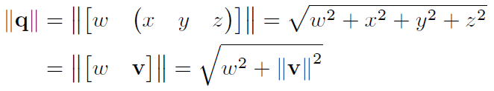
Quaternion Magnitude
The magnitude of a quaternion is

Slide 112
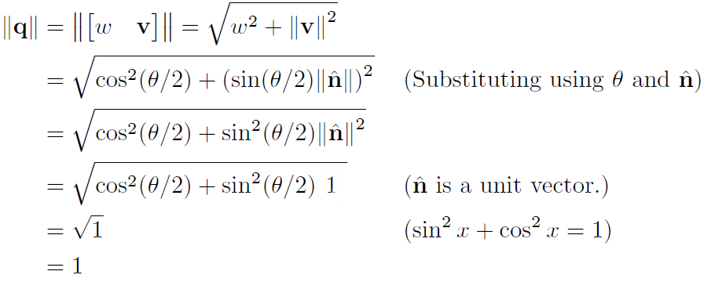
Rotation Quaternion Magnitude
The magnitude of a rotation quaternion is 1.

Slide 113
Conjugate and Inverse
The conjugate of a quaternion is obtained by reversing the vector part.
q* = [ w v ]* = [w –v ].
The inverse of a quaternion is its conjugate divided by its magnitude.
q⁻¹ = q*/|| q ||.
For unit quaternions, in particular rotation quaternions, conjugate is the same as inverse
[ w v ]* = [ w v ]⁻¹.
The inverse of a rotation quaternion is a rotation in the opposite direction.

Slide 114
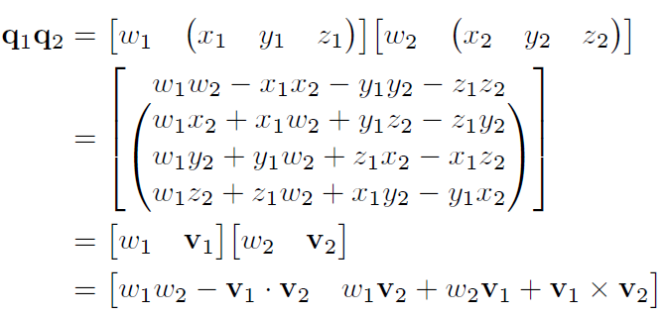
Quaternion Multiplication

Slide 115
Facts About Quaternion Multiplication
It is associative but not commutative.
q(rs) = (qr)s qr ≠ rq
Multiplicative identity is [1 0] = [1 ( 0 0 0 )]
||qr|| = ||q|| ||r||, so unit quaternions are closed under multiplication.
(ab)⁻¹ = b⁻¹a⁻¹, and in general (just like matrices)
(q₁q₂…q_{n-1}q_{n})^{–1} = q_{n}^{–1}q_{n-1}^{–1}…q₂^{–1}q₁^{–1}

Slide 116
Quaternion Inverse Again
Assume [ w v ] is a unit quaternion (same kind of argument holds for general quaternions). Then,
[ w v ] [ w v ]⁻¹
= [ w v ] [ w –v ]
= [ w² – v.(–v) v x (–v) + wv – wv ]
= [w² + x² + y² + z² 0 ]
= [ 1 0 ] (because it’s a unit quaternion)

Slide 117
Applying Rotations to Points
To apply a rotation quaternion q to a 3D point p, use quaternion multiplication (thinking of p for a moment as the quaternion [1 p]):
qpq⁻¹.
Examine what happens when multiple rotations are applied to a vector. Rotate the vector p by the quaternion a, and then rotate that result by another quaternion b.
p' = b(apa⁻¹)b⁻¹
= (ba)p(a⁻¹b⁻¹)
= (ba)p(ba)⁻¹.

Slide 118
Concatenating Rotations
Notice that rotating by a and then by b is equivalent to performing a single rotation by the quaternion product ba.
Thus, quaternion multiplication can be used to concatenate multiple rotations, just like matrix multiplication.
We say “just like matrix multiplication,” but in fact there is a slightly irritating difference.
With matrix multiplication, our preference to use row vectors puts the vectors on the left, resulting in the nice property that concatenated rotations read left-to-right in the order of transformation.
With quaternions, we don't have this flexibility: concatenation of multiple rotations will always read from right to left.

Slide 119
Order of Multiplication
This means that to apply a rotation quaternion q followed by a rotation quaternion r, we apply the product quaternion qr:
r⁻¹(q⁻¹p q)r = (qr)⁻¹p (qr)
This is cool because quaternion multiplication is done the same order as the transformations.
Books that use column vectors often define quaternion product backwards – reversing the order of the cross product – to make the order natural for them.

Slide 120
Row vs. Column Vectors
Quaternion multiplication for row vectors:
[ q_{w}r_{w} – q_{v}.r_{v} q_{v} x r_{v} + r_{w} q_{v} + q_{w} r_{v} ]
Quaternion multiplication for column vectors:
[ q_{w}r_{w} – q_{v}.r_{v} r_{v} x q_{v} + r_{w} q_{v} + q_{w} r_{v} ]
Some books do it in the wrong order and just put up with the inconvenience.
Moral: Caveat Emptor

Slide 121
Quaternion Difference
Let a and b be quaternions representing two orientations.
The quaternion d that takes orientation a to orientation b is called the quaternion difference between a and b.
Want ad = b. What is d?
d = a⁻¹b
Why? ad = a(a⁻¹b) = (aa⁻¹)b = [ 1 0 ] b = b

Slide 122
Quaternion Dot Product
Similar to vector dot product:
q₁.q₂ = [ w₁ v₁ ] . [ w₂ v₂ ] = w₁ w₂+ v₁.v₂
If v₁ = [ x₁ y₁ z₁ ] and v₂ = [ x₂ y₂ z₂ ], then:
q₁.q₂ = w₁ w₂ + x₁ x₂ + y₁ y₂ + z₁ z₂
Geometric interpretation: the larger the absolute value of q₁.q₂, the more similar their orientations are.

Slide 123
Quaternion Log
As a shorthand, let α = θ/2. Let n be a unit vector. Suppose quaternion q = [cos α n sin α]
The logarithm of q, denoted log q, is defined to be [0, αn].
Note that log q is not necessarily a unit quaternion.
Also note the similarity between the logarithm of a quaternion and the exponential map format.

Slide 124
Quaternion Exponential
The exponential function for quaternions is defined in the exact opposite manner.
Suppose p = [0, αn], where n is a unit vector.
The exponential of p, denoted exp p, is defined to be [cos α n sin α].
Note that exp p is always a unit quaternion.
Quaternion log and exponential are inverses, that is, for all quaternions q,
exp(log q) = log(exp q) = q.

Slide 125
Multiplying a Quaternion by a Scalar
Given a scalar k and a quaternion q = [w v],
kq = k[w v] = [kw kv].
This will not usually result in a unit quaternion, which is why multiplication by a scalar is not for representing angular displacement.

Slide 126
Quaternion Exponentiation
We used the term “exponential” before, now it’s time for exponentiation.
If q is a quaternion and t is a scalar, define
q^{t} = exp (t log q).
As t varies from 0 to 1, the quaternion q^{t} varies from [1, 0] to q.
Quaternion exponentiation is useful because it allows us to extract a fraction of an angular displacement.
For example, q^{1/3} is a quaternion that represents 1/3rd of the angular displacement represented by the quaternion q.

Slide 127
Facts About Quaternion Exponentiation
Exponents t outside the range 0 ≤ t ≤ 1 behave mostly as expected, with one major caveat.
For example, q² represents twice the angular displacement as q.
If q represents a clockwise rotation of 30° about the x-axis, then q² represents a clockwise rotation of 60° about the x-axis, and q^{–1/3} represents a counterclockwise rotation of 10° about the x-axis.
Notice that q^{–1} yields the quaternion inverse.

Slide 128
The Caveat
The caveat we mentioned is this: a quaternion represents angular displacements using the shortest arc. Multiple spins cannot be represented.
For example, if q represents a clockwise rotation of 30° about the x-axis, then q⁸ is not a 240° clockwise rotation about the x-axis as expected; it is a 120° counterclockwise rotation.
Of course, rotating 240° in one direction produces the same end result as rotating 120° in the opposite direction, and this is the point: quaternions only really capture the end result.

Slide 129
In Consequence
If further operations on this quaternion were performed, things will not behave as expected. For example, (q⁸)^{1/2} is not q⁴, as we would intuitively expect.
In general, many of the algebraic identities concerning exponentiation of scalars, such as (a^{s})^{t} = a^{st}, do not apply to quaternions.
In some situations, we do care about the total amount of rotation, not just the end result.
The most important example is that of angular velocity.
Quaternions are not the correct tool for this job; use the exponential map (or its cousin, the axis-angle format) instead.

Slide 130
Implementation Notes
Here’s why q^{t} interpolates from the identity quaternion to q as t varies from 0 to 1.
The log operation essentially converts the quaternion to exponential map format. (Except for a factor of 2.)
Then, when we perform the scalar multiplication by the exponent t, the effect is to multiply the angle by t.
Finally, the exp undoes what the log operation did, recalculating the new w and v from the exponential vector.
Direct implementation of the formula q^{t} = exp (t log q) as an algorithm for computing q^{t} can give rise to code that is more complicated than necessary.
Instead of working with a single exponential-map-like quantity like the formula tells us to, we will break out the axis and half-angle separately.

Slide 131
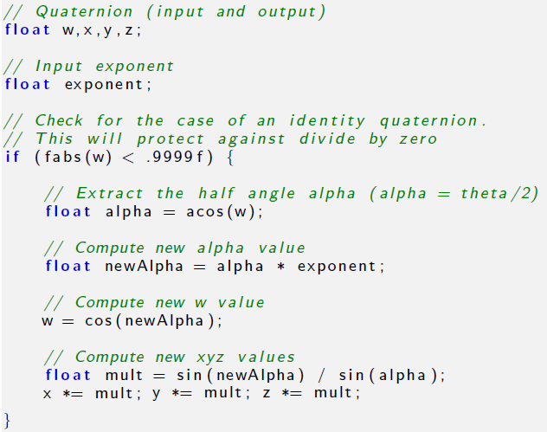

Slide 132
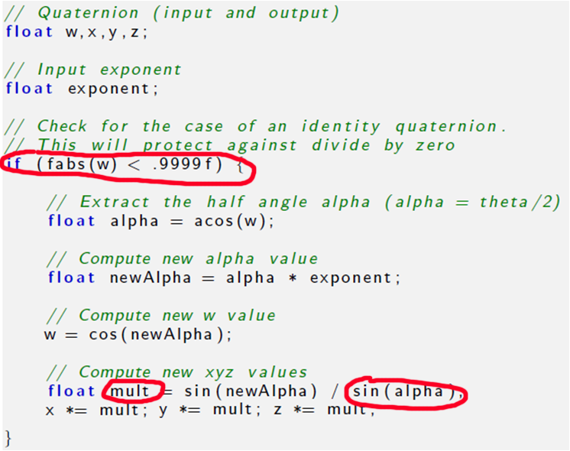
Notes About Code 1
The check for the identity quaternion is necessary since a value of w = 1 would cause the computation of mult to divide by zero.

Slide 133
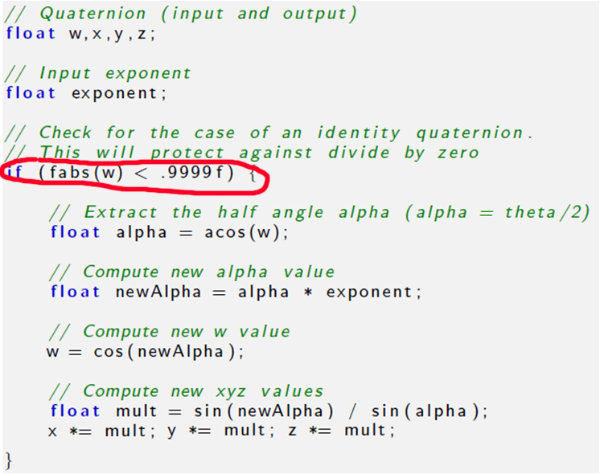
Notes About Code 2
Raising an identity quaternion to any power results in the identity quaternion, so if we detect an identity quaternion on input, we simply ignore the exponent and return the original quaternion.

Slide 134
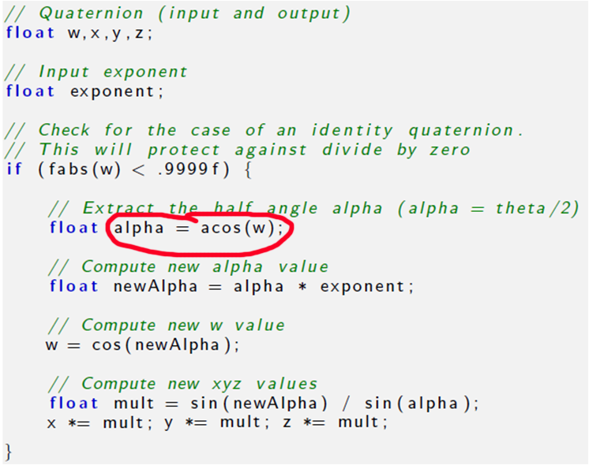
Notes About Code 3
We use the arccos function, which always returns a positive angle, to compute alpha. Any quaternion can be interpreted as having a positive angle of rotation, since negative rotation is the same as positive rotation about the opposite axis.

Slide 135
Quaternion Interpolation
The raison d'etre of quaternions in games and graphics today is an operation known as slerp, which stands for spherical linear interpolation.
Slerp allows us to smoothly interpolate between two orientations while avoiding all the problems that plagued interpolation of Euler angles.
Slerp is a ternary operator, meaning it accepts three operands, 2 quaternions and a scalar.

Slide 136
The Slerp Function
The first two operands the two quaternions q₀ and q₁ between which we wish to interpolate.
The third operand is the interpolation parameter, a real number t such that 0 ≤ t ≤ 1.
As t varies from 0 to 1, the slerp function slerp(q₀, q₁, t) will return an orientation that interpolates from q₀ to q₁ by fraction t.

Slide 137
Scalar Linear Interpolation
To interpolate between two scalar values a₀ and a₁, use the standard linear interpolation formula:
Δa = a₁ – a₀
lerp(a₀, a₁, t) = a₀ + t.Δa
This requires three basic steps:
Compute the difference between the two values
Take a fraction of this difference
Take the first value and adjust it by this fraction of the difference.

Slide 138
Slerp By Analogy to Lerp
We use the same idea to interpolate between orientations. Recall that quaternion multiplication reads right-to-left.
Compute the difference between the two values. The angular displacement from q₀ to q₁ is given by
Δq = q₁q₀⁻¹.
Take a fraction of this difference using quaternion exponentiation. The fraction of the difference is given by
(Δq)^{t}.
Take the original value and adjust it by this fraction of the difference by composing the angular displacements using quaternion multiplication, giving
(Δq)^{t} q₀.

Slide 139
The Slerp Equation
Putting these steps together,
slerp(q₀, q₁, t) = (q₁q₀⁻¹)^{t} q₀.
This is how slerp is computed in theory. In practice, a more efficient technique is used.
We start by interpreting the quaternions as existing in a 4D space. We are only interested in unit quaternions, which live on the surface of a 4D hypersphere.
We interpolate around the arc that connects the two quaternions, along the surface of the 4D hypersphere.
Hence the name spherical linear interpolation.

Slide 140
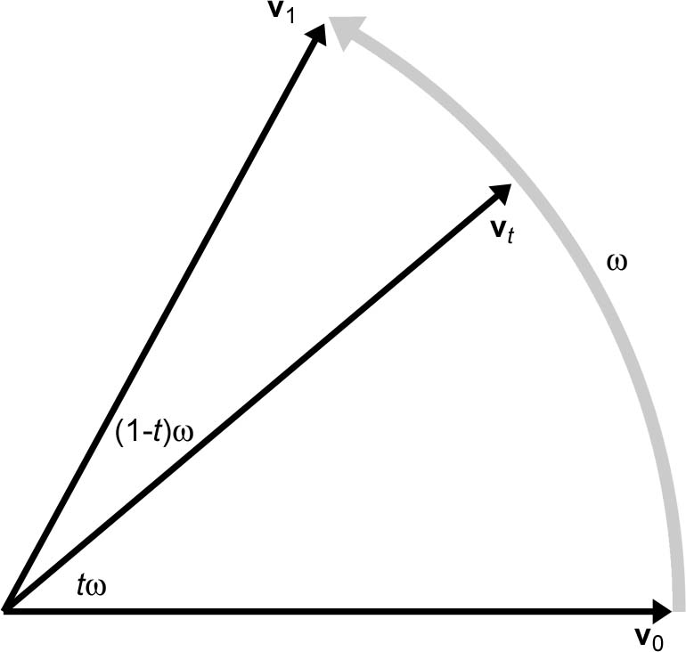
Visualize It in the Plane
Given unit length 2D vectors v₀ and v₁, compute v_{t}, the result of smoothly interpolating around the arc by a fraction t of the distance from v₀ to v₁, for some real number t such that 0 ≤ t ≤ 1.
If we let ω be the angle intercepted by the arc from v₀ to v₁, then v_{t} is the result of rotating v₀ around this arc by an angle of tω.

Slide 141
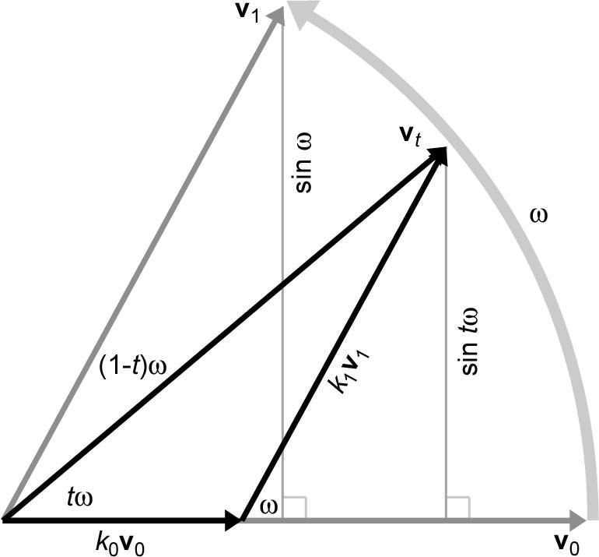
Visualize It in the Plane
Express v_{t} as a linear combination of v₀ and v₁.
That is, find nonnegative constants k₀ and k₁ such that v_{t} = k₀ v₀ + k₁ v₁.
Use elementary geometry to determine the values of k₀ and k₁ as in this diagram.

Slide 142
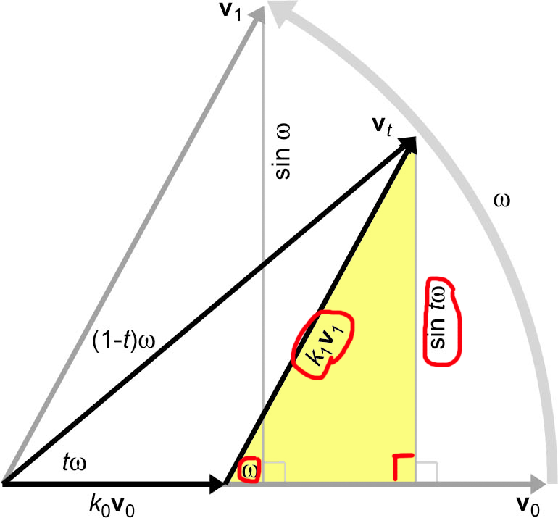
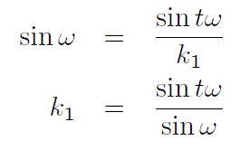
Solving for k₁
Applying some trig to the right triangle with hypotenuse k₁ v₁ (recalling that v₁ is a unit vector), we see that:

Slide 143
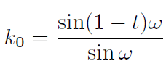
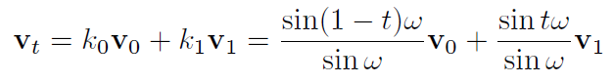
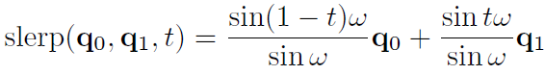
Continuing
Similarly,
And therefore,
Generalizing to quaternion space:

Slide 144
Computing ω
We need a way to compute ω, the angle between the two quaternions.
As it turns out, the analogy from 2D vector math can be carried into quaternion space; the quaternion dot product is cos ω.

Slide 145
Complication 1
There are two slight complications. First, the two quaternions q and –q represent the same orientation, but may produce different results when used as an argument to slerp.
This problem doesn't happen in 2D or 3D because the surface of a 4D hypersphere has a different topology than Euclidian space.
The solution is to choose the signs of q₀ and q₁ such that the dot product q₀∙q₁is nonnegative.
This has the effect of always selecting the shortest rotational arc from q₀ to q₁ .

Slide 146
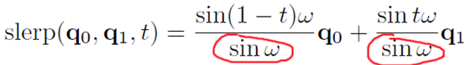
Complication 2
The second consideration is that if q₀ and q₁ are very close, then ω is very small, and thus sin ω is also very small, which will cause problems with the division.
To avoid this, if sin ω is very small, then use simple linear interpolation instead.
Next: some C code…

Slide 147
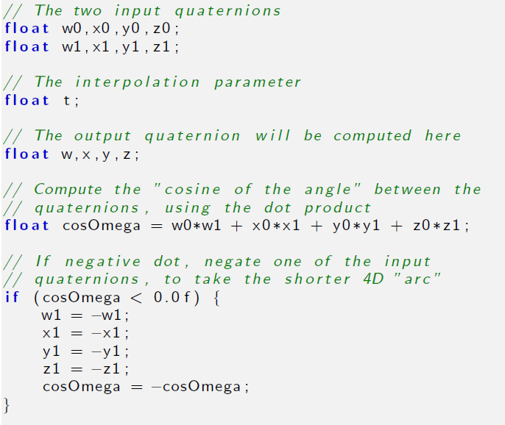

Slide 148
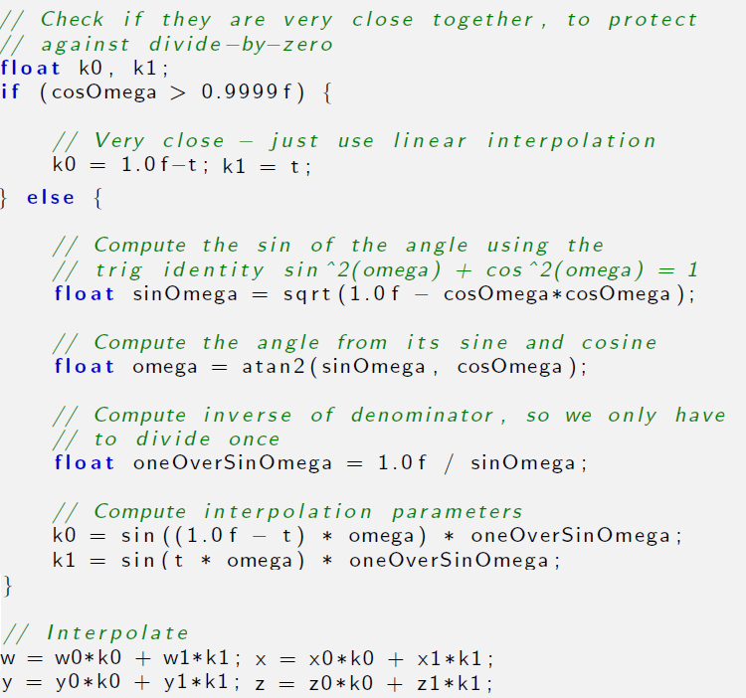

Slide 149
Advantages of Quaternions
Smooth interpolation. The interpolation provided by slerp provides smooth interpolation between orientations. No other representation method provides for smooth interpolation.
Fast concatenation and inversion of angular displacements. We can concatenate a sequence of angular displacements into a single angular displacement using the quaternion cross product. The same operation using matrices involves more scalar operations, though which one is actually faster on a given architectures is not so clean-cut: SIMD vector operations can make very quick work of matrix multiplication. Quaternion conjugate provides a way to compute the opposite angular displacement very efficiently. This can be done by transposing a rotation matrix, but is not easy with Euler angles.
Fast conversion to and from matrix form. As we will see later, quaternions can be converted to and from matrix form a bit faster than Euler angles.
Only four numbers. Since a quaternion contains four scalar values, it is considerably more economical than a matrix, which uses nine numbers. (However, it still is 33% larger than Euler angles.)

Slide 150
Disadvantages of Quaternions
However, these advantages do come at some cost. Quaternions suffer from a few of the problems that affect matrices, only to a lesser degree:
Slightly bigger than Euler angles. That one additional number may not seem like much, but an extra 33% can make a difference when large amounts of angular displacements are needed, for example, when storing animation data. And the values inside a quaternion are not evenly spaced from –1 to 1 so the component values do not interpolate smoothly even if the orientation does. This makes quaternions more difficult to pack into a fixed point number than Euler angles or an exponential map.
Can become invalid. This can happen either through bad input data, or from accumulated floating point round off error. (We can of course normalize the quaternion to ensure that it has unit magnitude.)
Difficult for humans to work with. Of the three representation methods, quaternions are the most difficult for humans to work with directly.

Slide 151
Section 8.6: Comparison of Methods

Slide 152
Comparison of Methods 1
Rotating points between coordinate spaces (object and upright)
Matrix: Possible, and often highly optimized by vector instructions.
Euler Angles: Impossible (must convert to rotation matrix)
Exponential Map: Impossible (must convert to rotation matrix)
Quaternion: On a chalkboard, yes. Practically, in a computer, not really. You might as well convert to rotation matrix.
Concatenation of multiple rotations
Matrix: Possible, and can often be highly optimized by vector instructions. Watch out for matrix creep.
Euler Angles: Impossible.
Exponential Map: Impossible.
Quaternion: Possible. Fewer scalar operations than matrix multiplication, but might not as easy to take advantage of SIMD instructions. Watch out for error creep.

Slide 153
Comparison of Methods 2
Inversion of rotations
Matrix: Easy and fast, using matrix transpose
Euler Angles: Not easy.
Exponential Map: Easy and fast, using vector negation
Quaternion: Easy and fast, using quaternion conjugate
Interpolation
Matrix: Extremely problematic
Euler Angles: Possible, but Gimbal lock causes quirkiness
Exponential Map: Possible, with some singularities, but not as troublesome as Euler angles.
Quaternion: Slerp provides smooth interpolation

Slide 154
Comparison of Methods 3
Direct human interpretation
Matrix: Difficult
Euler Angles: Easiest
Exponential Map: Very difficult
Quaternion: Very difficult
Storing in a memory or in a file
Matrix: Nine numbers
Euler Angles: Three numbers that can be easily quantized
Exponential Map: Three numbers that can be easily quantized
Quaternion: 4 numbers that don’t quantize well; can be reduced to 3 by assuming unit length and that 4th component is nonnegative.

Slide 155
Comparison of Methods 4
Unique representation for a given rotation
Matrix: Yes
Euler Angles: No, due to aliasing
Exponential Map: No, due to aliasing; less complicated than Euler angles.
Quaternion: Exactly two distinct representations for any angular displacement, and they are negatives of each other
Possible to become invalid
Matrix: Six degrees of redundancy inherent in orthogonal matrix. Matrix creep can occur.
Euler Angles: Any three numbers can be interpreted unambiguously
Exponential Map: Any three numbers can be interpreted unambiguously
Quaternion: Error creep can occur

Slide 156
How to Choose Representation 1
Euler angles are easiest for humans to work with. Using Euler angles greatly simplifies human interaction when specifying the orientation of objects in the world.
This includes direct keyboard entry of an orientation, specifying orientations directly in the code (e.g. positioning the camera for rendering), and examination in the debugger.
This advantage should not be underestimated. Certainly don't sacrifice ease of use in the name of optimization until you are certain that your optimization will make a difference in practice.

Slide 157
How to Choose Representation 2
Matrix form must eventually be used if vector coordinate space transformations are needed.
However, this doesn't mean you can't store the orientation using another format and then generate a rotation matrix when you need it.
An alternative solution is to store the main copy of the orientation using Euler angles or a quaternion, but also maintain a matrix for rotations, re-computing this matrix anytime the main copy changes.

Slide 158
How to Choose Representation 3
For storage of large numbers of orientations (e.g. animation data), Euler angles, exponential maps, and quaternions offer various tradeoffs.
In general, the components of Euler angles and exponential maps quantize better than quaternions.
It is possible to store a rotation quaternion in only three numbers; by assuming the fourth component is nonnegative and the quaternion has unit length it can be computed from the three that are stored.

Slide 159
How to Choose Representation 3
Reliable quality interpolation can only be accomplished using quaternions.
However, even if you are using a different form you can always convert to quaternions, perform the interpolation, and then convert back to the original form.
Direct interpolation using exponential maps might be a viable alternative in some cases, since the points of singularity are at very extreme orientations and are often easily avoided in practice.

Slide 160
How to Choose Representation 4
For angular velocity or any other situation where extra spins over and above 360° need to be represented, use the exponential map or axis-angle.

Slide 161
Section 8.7: Converting Between Representations

Slide 162
Conversion Algorithms
Euler angles to rotation matrix.
Rotation matrix to Euler angles.
Quaternion to matrix.
Matrix to quaternion.
Euler angles to quaternion.
Quaternion to Euler angles.

Slide 163
Euler Angles to Matrix 1
Euler angles represent a transformation of inertial space axes to object space axes.
We want a matrix to transform points.
Of course, it matters whether we want to go from inertial to object space or the other way around.
Let’s start with object to upright space, since that’s how Euler angles are defined.
Since transforming axes is the opposite of transforming points, we need to negate the angles.

Slide 164
Euler Angles to Matrix 2
Create rotation matrices for heading, pitch, and bank angles, then multiply the matrices.
M_{object→upright} = BPH
B, P, and H are the rotation matrices for bank, heading, and pitch, which rotate about the z, x, and y-axis, respectively.

Slide 165
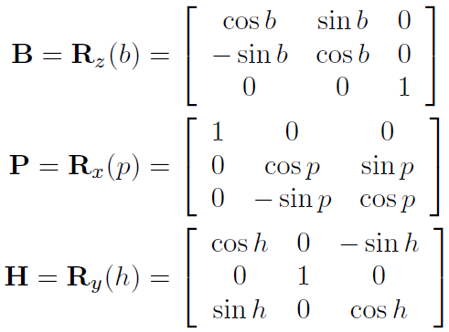
Euler Angles to Matrix 3

Slide 166
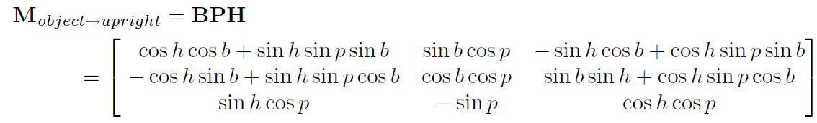
Euler Angles to Matrix 4

Slide 167
Euler Angles to Matrix 5
To transform points from object to upright space, it’s just the inverse of the matrix we just saw.
And the inverse of a rotation matrix is its transpose.
M_{upright→object} = (M_{object→upright} )⁻¹
= (M_{object→upright} )^{T}

Slide 168
Matrix to Euler Angles 1
We must know which rotation the matrix performs: either object-to-upright or upright-to-object. Here, we will develop a technique using the upright-to-object matrix.
The process of converting an object-to-upright matrix to Euler angles is supposedly very similar.
For any given angular displacement, there are an infinite number of Euler angle representations due to Euler angle aliasing.
The technique presented here will always return canonical Euler angles, with heading and bank in range ±180° and pitch in range ±90°.

Slide 169
Matrix to Euler Angles 2
Some matrices may be malformed, and so we must be tolerant of floating point precision errors.
Some matrices contain transformations other than rotation, such as scale, mirroring, or skew.
The technique described here only works on proper rotation matrices, perhaps with the usual floating point imprecision, but nothing grossly out of orthogonality.
If it's given a non-orthogonal matrix, the results are unpredictable.
With those considerations in mind, we set out to solve for the Euler angles from the rotation matrix equation directly.

Slide 170
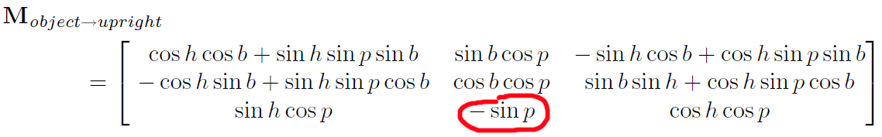
Matrix to Euler Angles 3
Solve for p from m₃₂
m₃₂ = –sin p
p = asin (–m₃₂)

Slide 171
Matrix to Euler Angles 4
The C standard library function asin()returns a value in the range –π/2 to π/2 radians, which is –90° to +90°, exactly the range of values we wish to return for pitch.
Now that we know p, we also know cos p. Let us first assume that cos p ≠ 0. We can determine sin h and cos h by dividing m₃₁ and m₃₃ by cos p, as follows:
m₃₁ = sin h cos p
∴ sin h = m₃₁ / cos p
and
m₃₃ = cos h cos p
∴ cos h = m₃₃ / cos p

Slide 172
Matrix to Euler Angles 5
Once we know the sine and cosine of an angle, we can compute the value of the angle using the SDK function atan2f().
tan h = sin h / cos h
h = atan (sin h / cos h) = atan2(sin h , cos h)
This function returns an angle from –π to π radians, which is –180° to +180°, our desired output range.

Slide 173
Matrix to Euler Angles 6
atan2(y, x) works by taking the arctangent of y/x using the signs of the two arguments to determine the quadrant of the returned angle. Since cos p > 0, the divisions do not affect the quotient and are, therefore, unnecessary.
Thus, heading can be computed more simply by:
h = atan2(sin h, cos h)
= atan2(m₁₃ /cos p, m₃₃ /cos p)
= atan2(m₁₃ , m₃₃ )

Slide 174
Matrix to Euler Angles 7
Now we have pitch and heading. Bank is similar to heading:
b = atan2(m₂₁ , m₂₂ )
We skipped the case cos p = 0.
If cos p = 0, then p = ±90° (looking straight up or straight down).
This is the gimbal lock case.

Slide 175
Matrix to Euler Angles 8
Arbitrarily assign all rotation about the vertical axis to heading and set bank equal to zero. So,
cos p = 0
b = 0
Which means
sin b = 0
cos b = 1

Slide 176

Matrix to Euler Angles 9

Slide 177

Matrix to Euler Angles 10

Slide 178

Matrix to Euler Angles 11

Slide 179

Quaternion to Matrix 1
Start by reverse engineering the matrix for rotating around an arbitrary axis n = (n_{x}, n_{y}, n_{z}) from Chapter 5.
See if we can rearrange it so that the parts of a quaternion leap out at us.

Slide 180
Quaternion to Matrix 2
We’re trying to manipulate the matrix so that the following values pop out at us:
w = cos(θ/2)
x = n_{x} sin(θ/2)
y = n_{y} sin(θ/2)
z = n_{y} sin(θ/2)
there are really only two major cases to handle: the diagonal elements and the off-diagonal elements.

Slide 181

Quaternion to Matrix 3
Let's start with the diagonal elements of the matrix. We'll work through m₁₁ here; m₂₂ and m₃₃ can be solved similarly.

Slide 182

Quaternion to Matrix 4

Slide 183

Quaternion to Matrix 5
Now we need to replace the cos θ term with something that contains cos θ/2 or sin θ/2, since the components of a quaternion contain those terms.
Let α = θ/2. We'll write one of the double-angle formulas for cosine from Section 1.4.4 in terms of α, and then substitute in θ.

Slide 184

Quaternion to Matrix 6
Substituting for cos θ, we have

Slide 185

Quaternion to Matrix 7
Since n is a unit vector, n_{x}² + n_{y}² + n_{z}² = 1, and therefore 1 – n_{x}² = n_{y}² + n_{z}² , so:
As we said, elements m₂₂ and m₃₃ are derived in a similar fashion.

Slide 186

Quaternion to Matrix 8
Now let's look at the non-diagonal elements of the matrix; they are easier than the diagonal elements. We'll use m₁₂ as an example.
We'll need the reverse of the double-angle formula for sine.
sin 2α = 2 sin α cos α
sin θ = 2 sin (θ/2) cos (θ/2)

Slide 187

Quaternion to Matrix 9
As we said, the other nondiagonal elements are derived in a similar fashion.

Slide 188

Quaternion to Matrix 10
Finally, we present the complete rotation matrix constructed from a quaternion:
Other variations can be found in other sources. For example m₁₁ = –1 + 2w² + 2z² also works, since w² + x² + y² + z² = 1.

Slide 189
Matrix to Quaternion 1
To extract a quaternion from a rotation matrix, reverse engineer the matrix from the last slide.

Slide 190


Matrix to Quaternion 2
Examining the sum of the diagonal elements (known as the trace of the matrix) we get:

Slide 191


Matrix to Quaternion 3
Therefore,
and similarly,

Slide 192
Matrix to Quaternion 4
Unfortunately, we cannot use this trick for all four components, since the square root will always yield positive results. (More accurately, we have no basis for choosing the positive or negative root.)
However, since q and –q represent the same orientation, we can arbitrarily choose to use the nonnegative root for one of the four components and still always return a correct quaternion.
We just can't use the above technique for all four values of the quaternion.
Another trick is to examine the sum and difference of diagonally opposite matrix elements.

Slide 193

Matrix to Quaternion 5

Slide 194
Matrix to Quaternion 6
Armed with these formulas, we use a two-step strategy.
Solve for one of the components of the trace.
Plug that value into one of the equations from the previous slide to solve for the other three.
This strategy boils down to selecting a row from the table on the next slide, then solving the equations in that row from left to right.

Slide 195

Matrix to Quaternion 7

Slide 196
Matrix to Quaternion 8
The only questions is, which row should we use? Which component should we solve for first?
The simplest strategy would be to just pick one arbitrarily and always use the same procedure, but this is fraught with problems.
Let's say we choose to always use the top row, meaning we solve for w from the trace, and then for x, y, and z with the equations on the right side of the arrow.
But if w = 0, the divisions to follow will be undefined.
Even if w > 0, a small w will produce numeric instability.
Shoemake suggests the strategy of first determining which of w, x, y, and z has the largest absolute value, computing that component using the diagonal of the matrix, and then using it to compute the other three according to the table on the previous slide.

Slide 197


Slide 198


Slide 199


Slide 200
Euler Angles to Quaternion 1
Similar to how we converted Euler angles to a rotation matrix.
Convert heading, pitch, and bank to the corresponding quaternions, then use quaternion multiplication to get the composite transformation.
Just as with matrices, there are two cases to consider: one when we wish to generate an object→upright quaternion, and a second when we want the upright→object quaternion.
Since the two are conjugates, we will only walk through the derivation for the object→upright quaternion.

Slide 201

Euler Angles to Quaternion 2
Suppose we start with Euler angles h, p, and b for heading, pitch, and bank.
Let h, p, and b be quaternions which perform the rotations about the y, x, and z-axes, respectively.

Slide 202
Euler Angles to Quaternion 3
Now to concatenate these in the correct order. We have two sources of backwardness that cancel each other out.
We will use fixed-axis rotations, so the order of rotations will actually be bank, then pitch, then heading.
However, quaternion multiplication performs the rotations from right-to-left.

Slide 203

Euler Angles to Quaternion 4

Slide 204


Euler Angles to Quaternion 5
The upright→object quaternion is simply the conjugate:

Slide 205

Quaternion to Euler Angles 1
Similar to how we converted a rotation matrix to Euler angles. Pitch:

Slide 206

Quaternion to Euler Angles 2
Heading:

Slide 207

Quaternion to Euler Angles 3
Bank:

Slide 208
Quaternion to Euler Angles 4
Some code next.
Convert an object→upright quaternion into Euler angles.
Convert an upright→object quaternion into Euler angles.

Slide 209


Slide 210


Slide 211
That concludes Chapter 8. Next, Chapter 9: Geometric Primitives

